Slide 1
Plant LifeCycle Management and web3D visualization for Nuclear Power Plants
Thomas Paviot, Arts et Métiers ParisTech
Thomas.paviot@ensam.eu

Slide 2
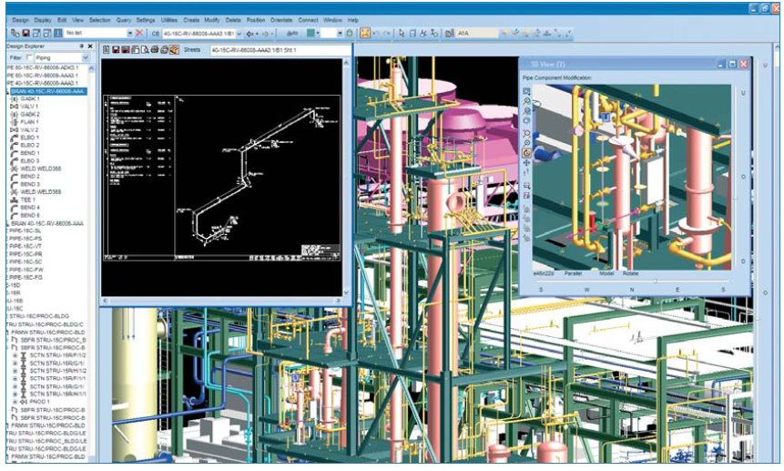
Industrial and scientific context
The current situation : AVEVA PDMS as a 3D CAD tool for nuclear power plant engineering
Key features :
Database storage
Placing components
Pipe routing, interference checks etc.
Spécification
Spécification
how to get independent from proprietary CAD software for long term 3D data retention ?
Industrial need : design and implement a (neutral) data model able to represent nuclear power plants 3D data in order to keep control over data generated from 3D CAD packages.
-2-

Slide 3
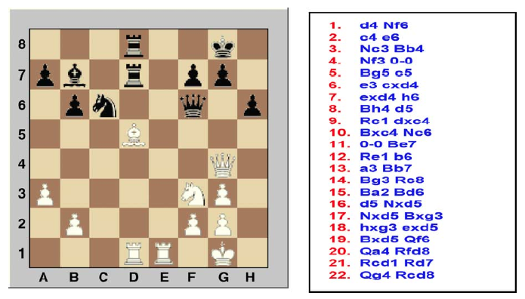
Representing 3D data : static and dynamic approaches
Approximated representation (mesh) + 3D scene parameters for visualization
JT, 3DXML, PDF3D etc.: software editors dependent, visualization needs a proprietary plugin.
ISO 10303-242 : not an IS yet
Exact representation (BREP, CSG):
ISO 10303-42 (STEP) : wide industrial use
IGES 5.1 : out of date
COLLADA 1.5 : no industrial use yet
Procedural representation
ISO 10303-55 and 108 : not supported by any common CAD package so far, implementation issues (no standard API). Interesting semantics.
Macro-Parametric Approaches : collaborative work oriented, no standard
Domain Specific Languages : no standard
from (Pratt, 2005)
-3-

Slide 4
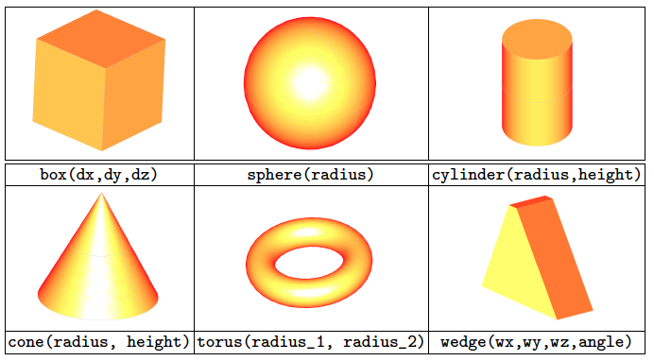
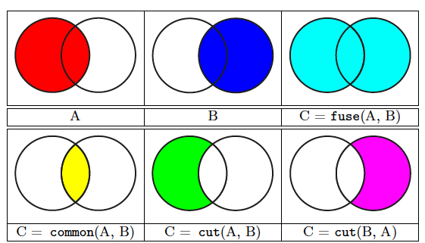
Modeling data – Macro Procedural Approach
Dynamic Language
The model :
CSG based
volume primitives
boolean operations
Utilities (cog, inertia matrix, surface computation etc.)
-4-

Slide 5
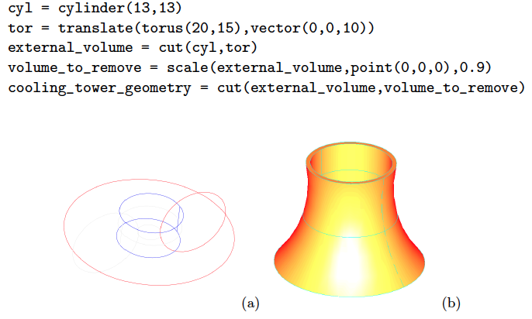
Experiment - 1
Modeling a cooling tower in just a few lines
Explicit representation
Human readable
Concise and short
Easy to modify (parametric approach)
-5-

Slide 6
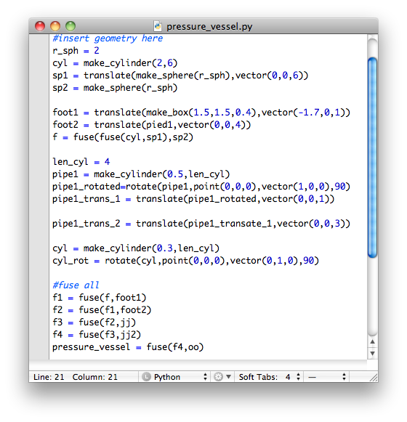
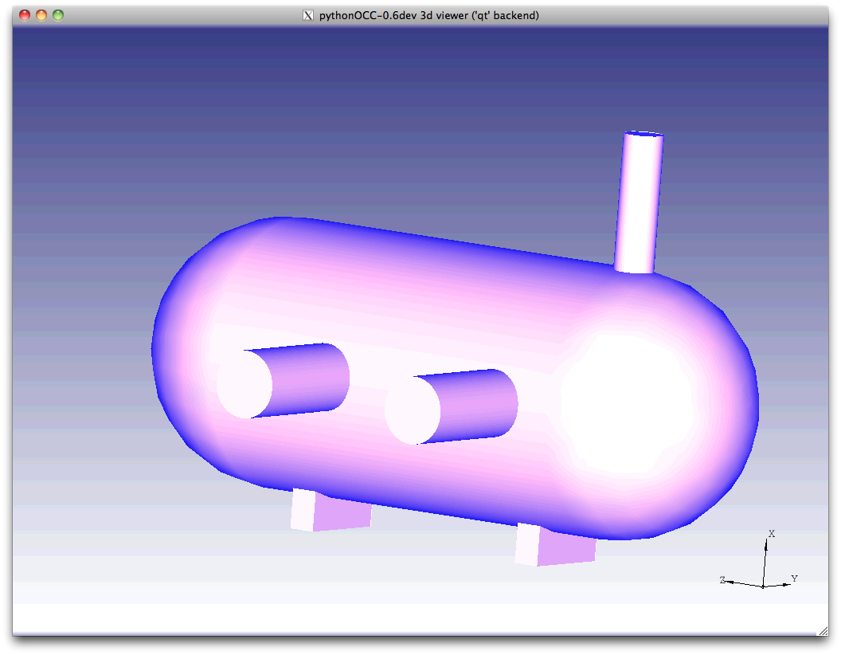
Experiment 2 – Modeling a pressure vessel
Language interpretor
Rendering
Component description
-6-

Slide 7
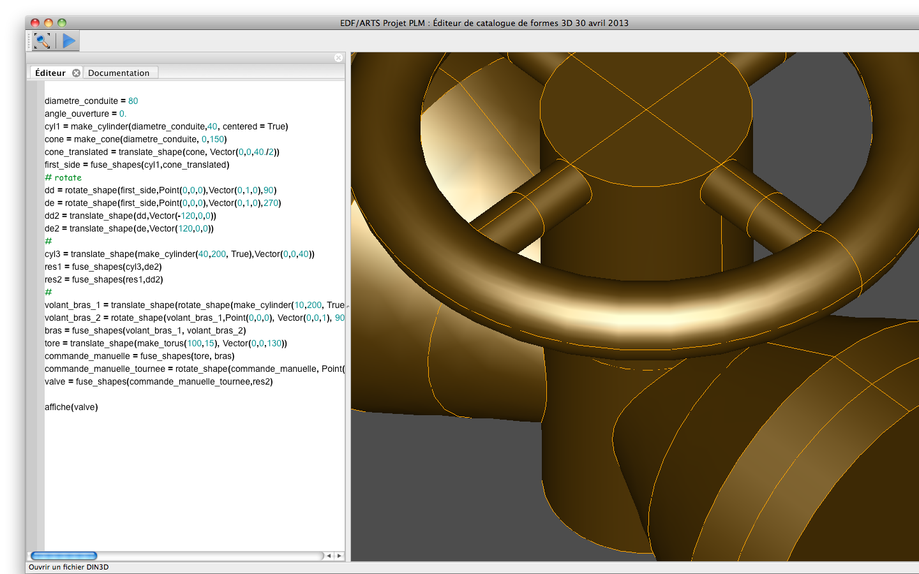
Experiment – 3 -
A component geometry editor / intepretor
9th International Conference on Product Lifecycle Management
PLM12
-7-
Notes:
L’idée de cette diapo, c’est de montrer qu’on peut décrire n’importe quelle forme géométrique à partir d’un court programme explicite. Plutôt que de développer un DSL, on a développé une API sur un langage généraliste (Python en l’occurrence).
Python est un langage de haut niveau, interprété.
Codé en Python, interface Qt, bibliotheque 3D pythonocc.

Slide 8
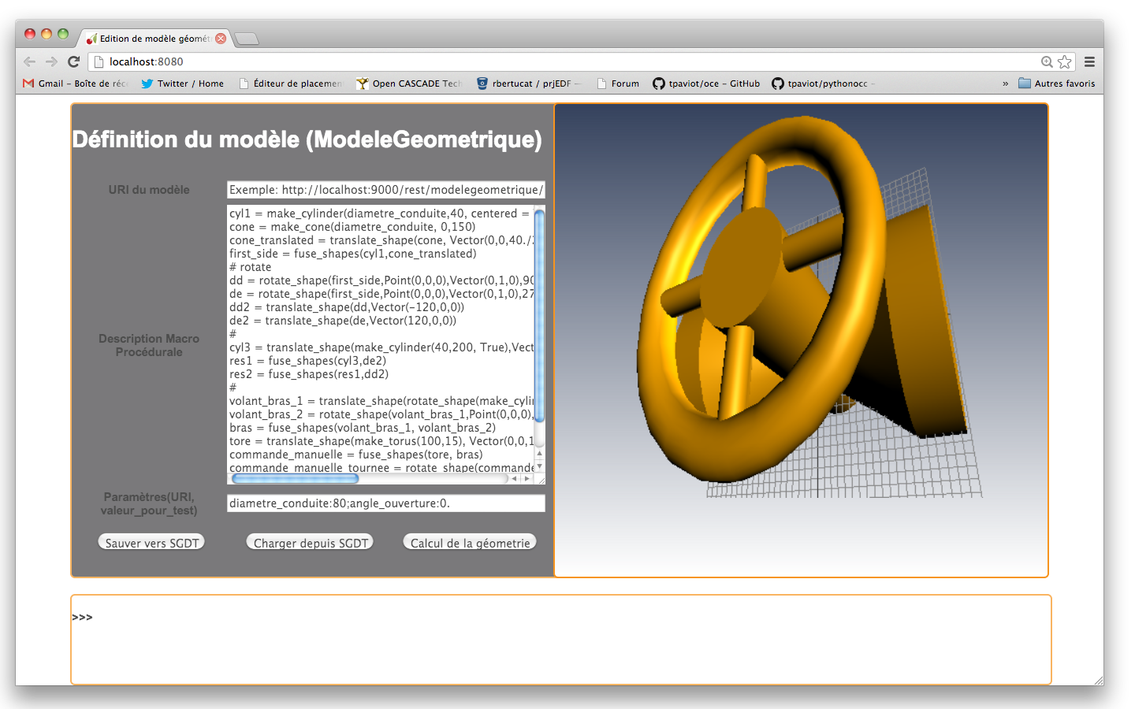
Experiment – 4 Towards online component creation
A webbased component editor
-8-

Slide 9
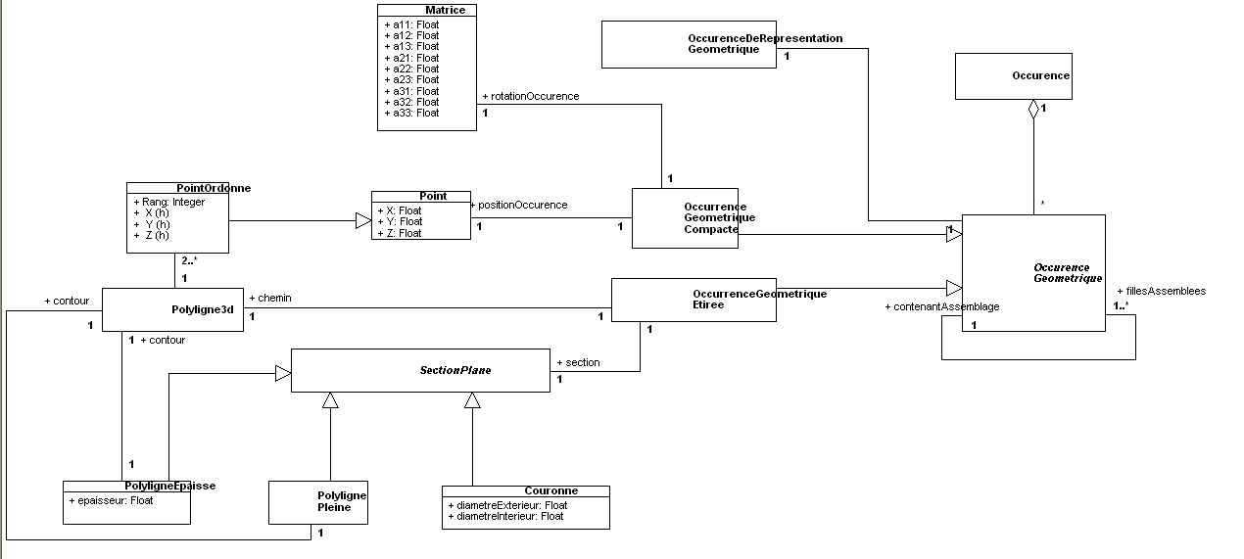
Modeling data – Placement model
MPA representation
Business model – Nuclear industry semantics (valves, pipes etc.)
-9-

Slide 10
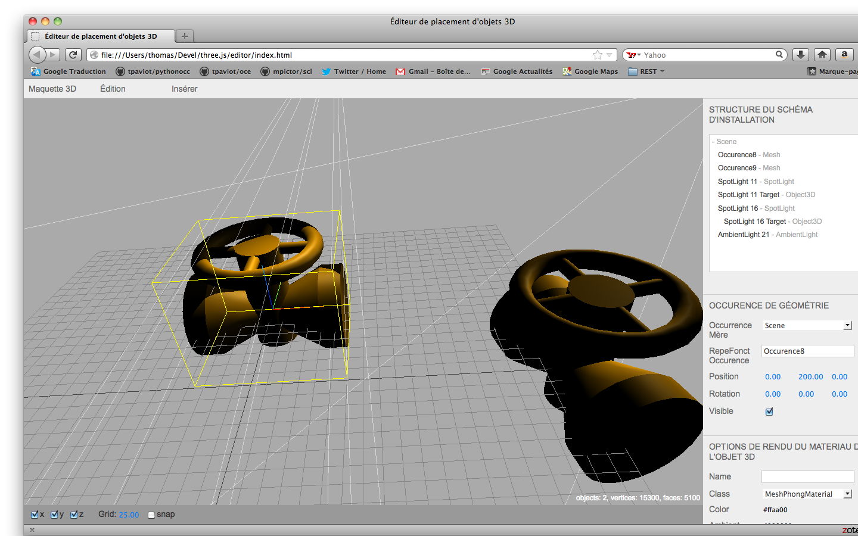
Experiment – Online component placement
A webbased component editor
-10-

Slide 11
Thank you for your attention
Please see our poster:
“Long term control of 3D engineering data for nuclear power plants”
Thomas Paviot (Arts et Métiers ParisTech),
Christophe Mouton (EDF - PLM project for Nuclear),
Samir Lamouri (Arts et Métiers ParisTech).

